Slide 1

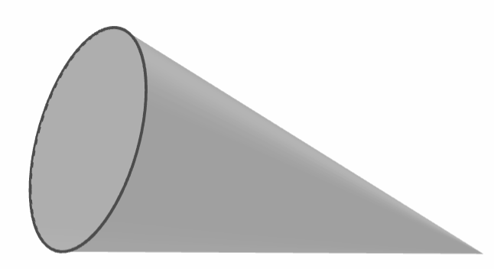
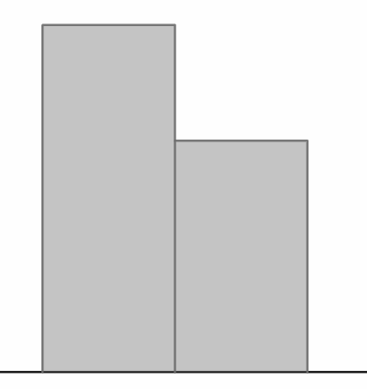
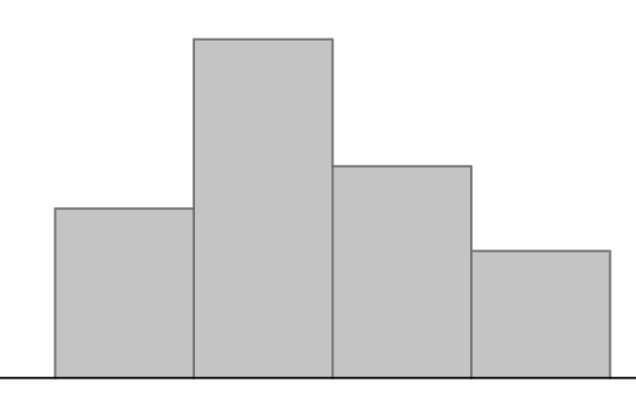
Experiments to determine how likely an outcome is
Task A: Planning and conducting experiments
1) A dropped cone could land in one of two ways: ‘base down’ or ‘curve down’.
a) Plan an experiment to investigate which outcome is most likely to happen.
A - base down
B - curve down
b) The bar chart shows the results from an experiment. The cone is about to be dropped again. In which position is it most likely to land?
6
4
frequency
2
0
A
B
c) Use the link to access a simulation of this experiment: Cone simulation🖇 Press the ‘run’ button to begin the simulation and the ‘reset’ button to start again. Try this multiple times with a large number of trials each time. How do the results affect your answers to part (b)?
2) A toy brick that is thrown into the air could land in one of four possible ways. In an experiment, the toy brick is thrown 20 times and produces the following results.
A - up
B - down
8
6
frequency
4
C - long face
D - short face
2
0
A
B
C
D
a) The toy brick is about to be thrown again. Draw a scale of likelihoods and use the results from the experiment to show the likelihood of each outcome on the scale.
b) Use the link to access a simulation of this experiment: Toy brick simulation🖇 Press the ‘run’ button to begin the simulation and the ‘reset’ button to start again. Try this multiple times with a large number of trials each time. How do the results affect your answers to part (a)?

Slide 2
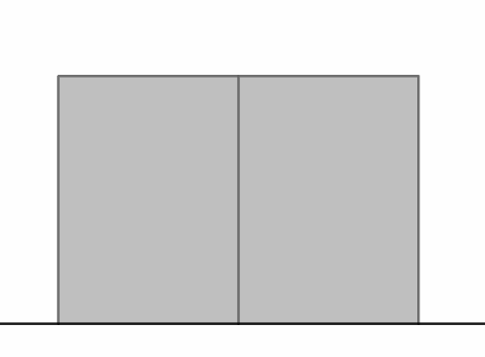
Experiments to determine how likely an outcome is
Task B: Considering the number of trials required
1) A class investigates which outcome is most likely when a frisbee is flipped.
a) An experiment is conducted with 10 trials. The bar chart shows the results.
Does one outcome appear more likely to happen than the other? If so, which one?
6
4
frequency
2
0
heads
tails
b) Use the link to access a simulation of this experiment: Frisbee flip simulation🖇 The box that says ‘count’ shows the number of trials completed. Press the ‘run’ button to begin the simulation and let it run for at least 500 trials.
How do the results from this experiment differ to those in part (a)?
c) Which experiment’s results seem more reliable? Justify your answer.
Mathematics in Education and Industry
v2.3

